Slide 1




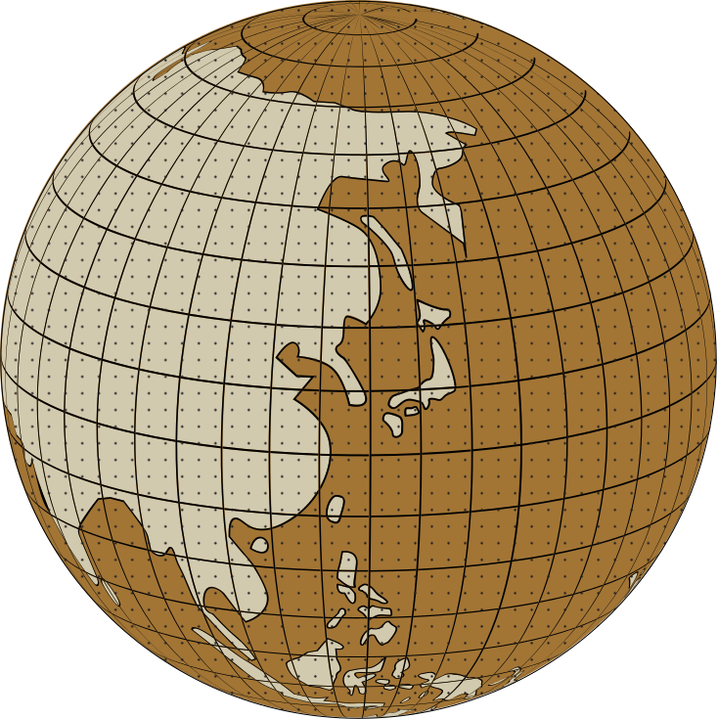
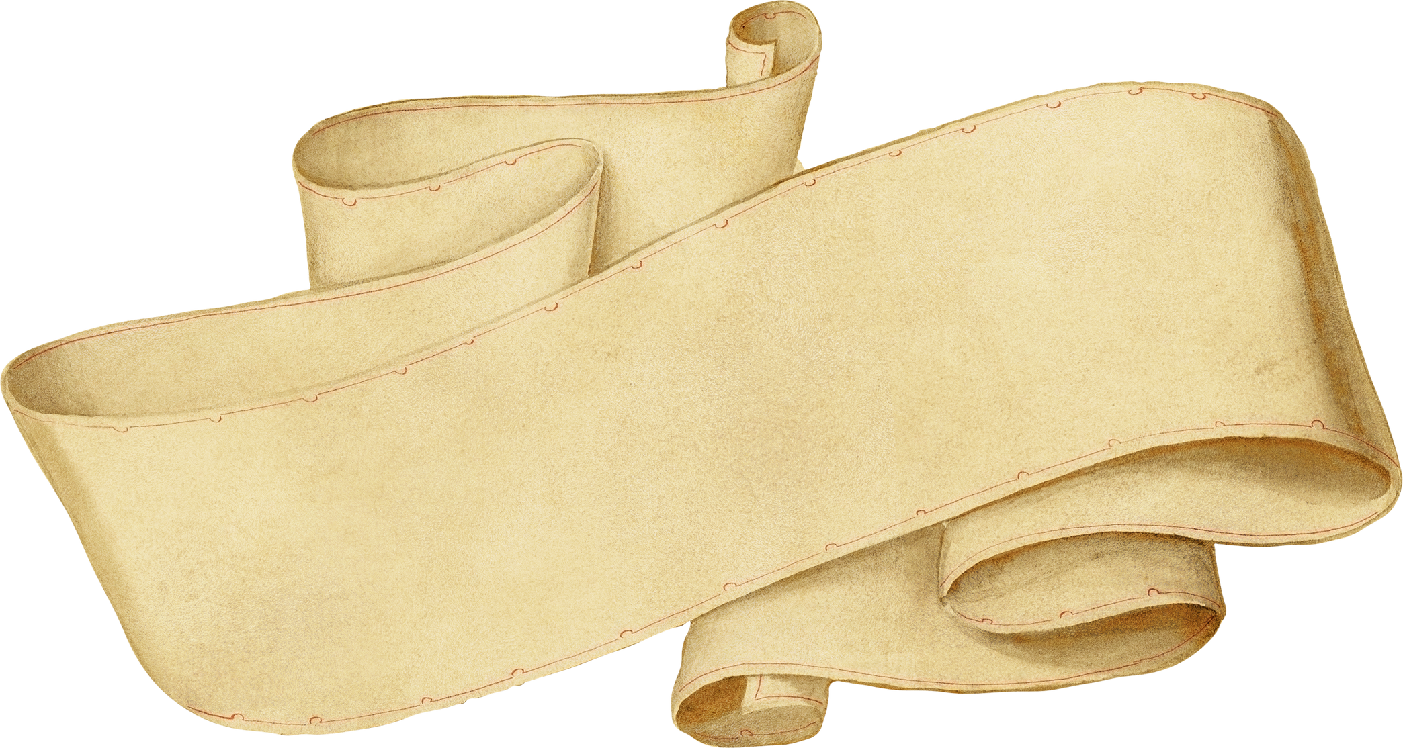



Functions
C Language

Slide 2


Contents
Introduction
Types of Fuctions
Elements of a user defined function
Arguments
Passing Parameters
Categories of Function
Variable Scope

Slide 3

Introduction
Function is a piece of code which takes some input, do some computations or processing on those inputs and give output.
Simply, function is a group of statements that perform specific task.
Why Functions?
Reusability
Readability
Easy to debug the code
Better memory utilization
Time saving

Slide 4
Types
Predefined Functions
It is also referred to as a “built-in function”. A compiler package already exists that contains these functions, each of which has a specific meaning and is included in the package. Built-in functions have the advantage of being directly usable without being defined.
Printf(), scanf(), main() and sqrt() are examples of library functions.

Slide 5
Types
User Defined Functions
Functions that the programmer creates are known as User-Defined functions or “tailor-made functions”. User-defined functions can be improved and modified according to the need of the programmer. Whenever we write a function that is case-specific and is not defined in any header file, we need to declare and define our own functions according to the syntax. whereas user-defined functions must be declared and defined before being used.

Slide 6

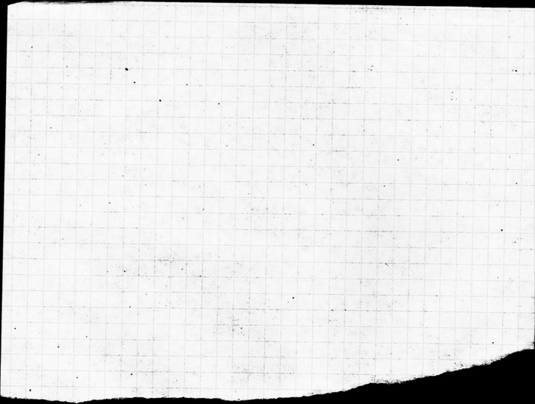
Elements of a user defined function
Function Declaration
Function Definition
Function
call

Slide 7
Function Declarations
In a function declaration, we must provide the function name, its return type, and the number and type of its parameters. A function declaration tells the compiler that there is a function with the given name defined somewhere else in the program.
Syntax
return_type name_of_the_function (parameter_1,parameter_2);

Slide 8
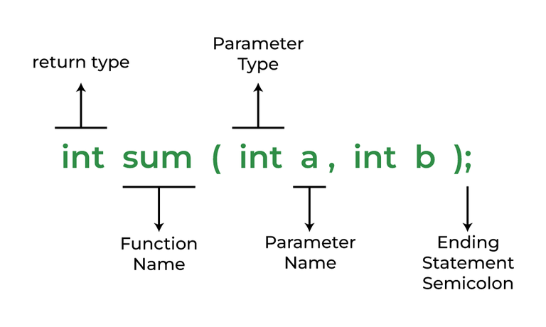
Function Declarations

Slide 9
Function Definition
The function definition consists of actual statements which are executed when the function is called.
Syntax:
return_type function_name (para1_type para1_name, para2_type para2_name)
{
// body of the function
}

Slide 10
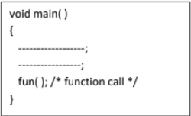
Function Call
A function call is a statement that instructs the compiler to execute the function. We use the function name and parameters in the function call.

Slide 11
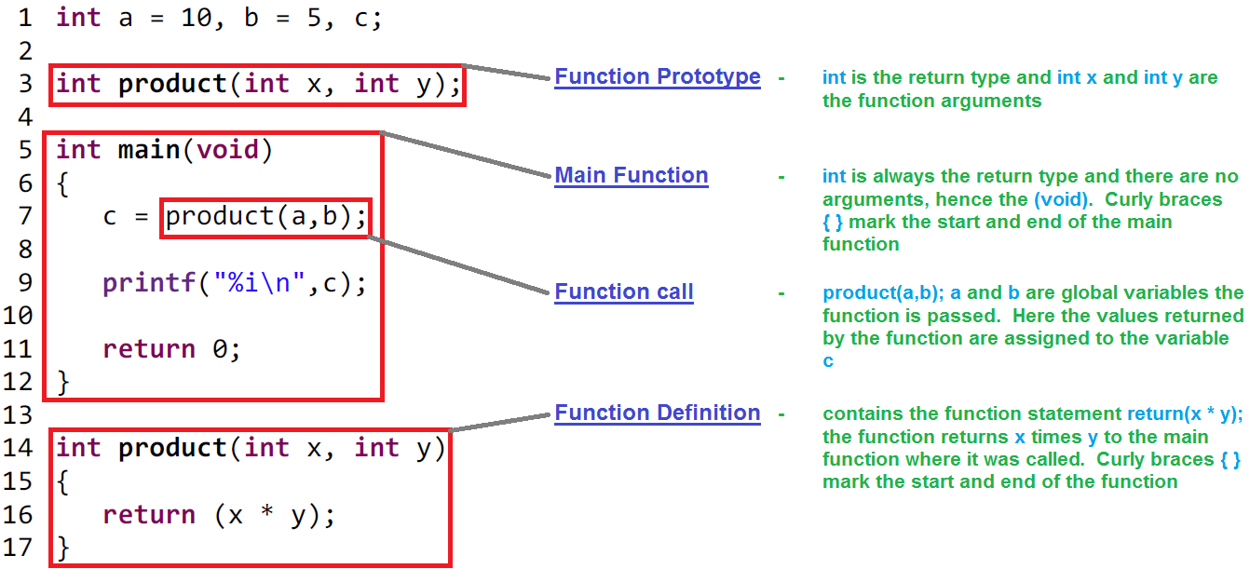

Slide 12
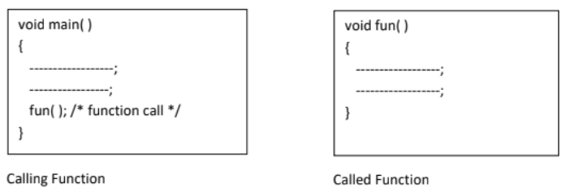
Calling Function and called function
Calling Function:
A function that calls another function is known as calling function.
Called Function:
A function which is called by another function is known as called function.
main() - calling
fun() - called

Slide 13
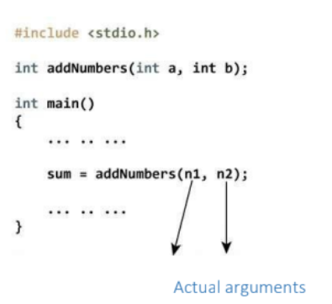
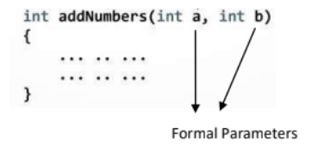
Arguments

Slide 14
Arguments
There are mainly two types of arguments/parameters:
Actual arguments
Formal arguments
Actual Arguments:
The data passed when the function is being invoked is known as the Actual parameters.
Formal Arguments:
Formal Parameters are the variable and the data type as mentioned in the function declaration.

Slide 15
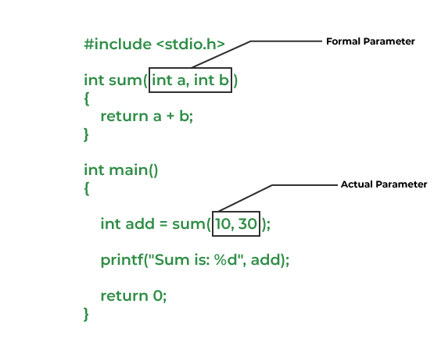
Arguments/parameters

Slide 16
Passing Parameters to Functions
We can pass arguments to the C function in two ways:
call by Value
call by Reference
Call by Value:
In call by value method, the value of the variable is passed to the function as parameter. The value of the actual parameter cannot be modified by formal parameter.
Different memory is allocated for both actual and formal parameters.

Slide 17
Example for call by value:
#include <stdio.h>
void swap(int var1, int var2){
int temp = var1;
var1 = var2;
var2 = temp;
}
int main(){
int var1 = 3, var2 = 2;
printf("Before swap Value of var1 and var2 is: %d, %d\n",var1, var2);
swap(var1, var2);
printf("After swap Value of var1 and var2 is: %d, %d",var1, var2);
return 0;
}
Parameter passing in this method copies values from actual parameters into formal function parameters. As a result, any changes made inside the functions do not reflect in the caller’s parameters.

Slide 18
Call by Reference:
In call by reference method, the value of the variable is passed to the function as parameter. The value of the actual parameter can be modified by formal parameter. Same memory is allocated for both actual and formal parameters.

Slide 19
Example for call by reference:
#include <stdio.h>
void swap(int *var1, int *var2){
int temp = *var1;
*var1 = *var2;
*var2 = temp;
}
int main(){
int var1 = 3, var2 = 2;
printf("Before swap Value of var1 and var2 is: %d, %d\n", var1, var2);
swap(&var1, &var2);
printf("After swap Value of var1 and var2 is: %d, %d",var1, var2);
return 0;
}

Slide 20
Conditions of Return Types and Arguments
Functions can be called either with or without arguments and might return values. They may or might not return values to the calling functions.
Function with no arguments and no return value
Function with no arguments and with return value
Function with argument and with no return value
Function with arguments and with return value

Slide 21
Function with no arguments and no return value
When a function has no arguments, called function does not receive any data from the calling function.
Syntax:
main ( )
{------------
Function1 ( ); //No arguments
--------------
}
Function1 ( )
{
-----------
return; // No return value
}

Slide 22
Function with no arguments and no return value
When a function has no arguments, it does not receive any data from the call:
#include<stdio.h>
void display();
void main(){
display();
}
void display() {
printf(“Welcome”);
return;
}

Slide 23
Function with no arguments and with return value
When a function has no arguments, it does not receive any data from the calling function. Similarly, when it does not return a value, the calling function does not receive any data from the called function.
Syntax:
main ( )
{------------
Function1 ( ); //No arguments
--------------
}
Function1 ()
{-----------
return (value); // with return value
}

Slide 24
Function with no arguments and with return value
#include<stdio.h>
int add(void);
void main(){
int sum;
sum=add();
printf(“sum: %d“, sum);
}
int add(void) {
int a,b;
printf(“Enter two numbers:”);
scanf(“%d%d”,&a,&b);
return(a+b);
}

Slide 25
Function with argument and with no return value
When a function has arguments, it receives any data from the calling function but it returns no values. These are void functions with no return values.
Syntax:
main ( )
{------------
Function1 (a, b); // with arguments
}
Function1 ( x, y )
{-----------
return; // No return value
}

Slide 26
Function with argument and with no return value
#include<stdio.h>
void add(int x, int y);
void main(){
int a, b;
printf(“values for a and b: “);
scanf(“%d%d”, &a,&b);
add(a, b);
}
int add(int x, int y){
printf(“%d”, x+y);
}

Slide 27
Function with arguments and with return value
Syntax:
main()
{------------
Function1 (a, b); //with arguments
}
Function1 (x, y)
{
-----------
-----------
return (value); // with return value

Slide 28
Function with arguments and with return value
#include<stdio.h>
void add(int x, int y);
void main(){
int a, b, sum;
printf(“values for a and b: “);
scanf(“%d%d”, &a,&b);
sum=add(a, b);
}
int add(int x, int y){
return(x+y);
}

Slide 29
Scope of variable
There are three types of variables in C program they are:
1. Local variables
2. Global variables
Local variable:
The scope of the local variables will be within the function only. If you declare a variable in a function it it can be accessed within the function and you can’t be accessed outside the function.

Slide 30
Scope of variable
Global Variable:
The scope of global variables will be throughout the program. You can access these variables from anywhere in the program. These variables are defined outside the main function. So that, these variables can be access from the main function and all
other sub functions.

Slide 31
Scope of variable
Example for global variable:
#include<stdio.h>
int a, b; // global variables
void add() { // we are adding values of global a and b i.e. 10+15
printf("%d", a + b);
}
int main(){
a = 10;
b = 15;
add();
return 0;
}
we are now updating the values of global variables as you can see we dont need to redeclare a and bagain

Slide 32
Recursion
C Language

Slide 33
Contents
Introduction
Why Recursion?
Format of a recursive function
Recursion & Memory Visualization
Recursion VS Iteration

Slide 34
What is Recursion?
Recursion:
Any function which calls itself is called recursive.
A recursive method solves a problem by calling a copy of itself to work on smaller problem.
Recursive algorithms have 2 types of cases:
-Recursive Case
-Base Case
Base Case:
Every recursive function case must terminate at a base case.
Recursive Case:
Where the function calls itself to perform the subtask.

Slide 35
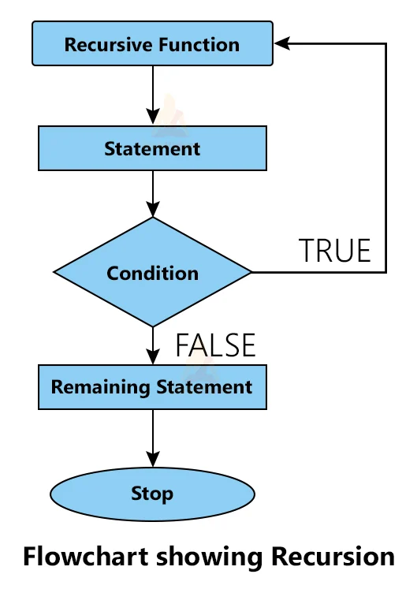
Recursion

Slide 36
Why Recursion?
Recursive code is generally shorter and easier to write than a iterative code.
Recursion is most useful for tasks that can be defined in terms of similar subtasks.
Recursion can reduce the time needed to write and debug code.
Using the call stack: Recursion can take advantage of the call stack to accomplish branching. For example, calling a function multiple times with different parameters inside the same loop.
Using a while loop: A recursive function and a while loop can be used to execute a piece of code without knowing how many times you need to repeat it

Slide 37
Format of a Recursive Function
A recursive function performs a task in part by calling itself to perform the subtasks.
if(test for base case)
return some base case value
else if(test for another base case)
return some other base case value
//the recursive case
else
return (some work and then a recursive call)

Slide 38
Consider the factorial function: n! is the product of all integers between n and 1. n!=1, if n=0
n!=n*(n-1)! if n>0
Here, the problem is determining the value of n!, and the subproblem is determining the value of (n-1)!.
In the recursive case, when n is greater than 1, the function call itself determine the value of (n-1)! and multiplies that with n.
In the base case, when n is 0 or 1, the function simply returns 1.
//calculates factorial of a positive integer
int fact(int n) {
if(n==1 || n==0) //base case fact of 0 or 1 is 1
return 1;
else //recursive case: multiply n by (n-1) !
return n*fact(n-1);
}

Slide 39
Factorial of a number
1! = 1
2! = 2*1 = 2
3! = 3*2*1 = 6
4! = 4*3*2*1 = 24
5! = 5*4*3*2*1 = 120
6! = 6*5*4*3*2*1 = 720

Slide 40
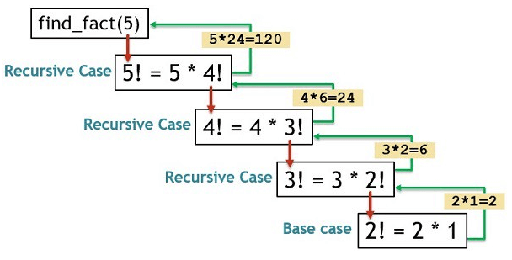
Factorial of a number
#include<stdio.h>
int fact(int n);
void main() {
int n, res = 0;
printf("Enter a number: ");
scanf("%d", &n);
res = fact(n);
printf("The output is %d", res);
}
int fact(int n) {
if (n == 0 || n == 1) {
return 1;
} else {
return n * fact(n - 1);
}
}

Slide 41
x= 5, y = 2
int fun1(int x, int y)
{
if (x == 0)
return y;
else
return fun1(x - 1, x + y);
}
A. 15
B. 12
C. 17
D. 20

Slide 42
#include <stdio.h>
int sum(int k);
int main() {
int result = sum(10);
printf("%d", result);
return 0;
}
int sum(int k) {
if (k > 0) {
return k + sum(k - 1);
} else {
return 0;
}
}
Which of the following are correct ?sum(5) = 15
sum(10) = 55
sum(15) = 100
sum(20) = 211

Slide 43
Recursion and Memory visualization
Each recursive call makes a new copy of that method (actually only the variables) in memory. Once a method ends (that is, returns some data), the copy of that returning method is removed from the memory.

Slide 44
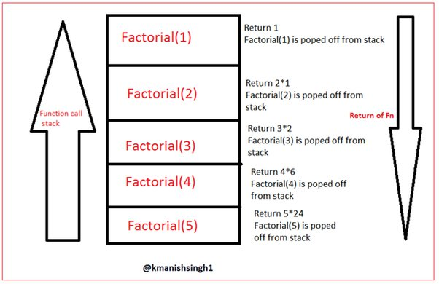
Memory Visualization

Slide 45

Recursion VS Iteration
Recursion
Iteration
Terminates when a condition is proven to be false.
Each iteration does not require extra space.
An infinite loop could loop forever since there is no extra memory being created.
Terminates when base
case is reached.
Each recursive call requires extra space on stack frame.
Program may run out of memory and result in stack overflow.

Slide 46
int n=21;
void fun2(int n)
{
if(n == 0)
return;
fun2(n/2);
printf("%d", n%2);
}
A. 10100
B. 10101
C. 10110
D. 10000

Slide 47
int fun1(int n)
{
if (n == 1)
return 0;
else
return 1 + fun1(n / 2);
}
n=12
n=20
A. 3 4
B. 4 3
C. 4 4
D. 3 3

Slide 48
int fun(int i)
{
if ( i%2 ) return (i++);
else return fun(fun( i - 1 ));
}
int main()
{
printf(" %d ", fun(1011));
getchar();
return 0;
}
A. 1000
B. 1011
C. 1012
D. Error

Slide 49
Examples and practice problems
Fibonacci series
Factorial Finding
Print numbers from 1 to n (i.e., increasing order)
Print numbers from n to 1 (i.e., decreasing order)
Print numbers in both increasing and decreasing order
Towers of Hanoi
Merge Sort
Quick Sort
Binary search

Slide 50
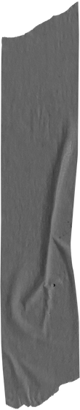
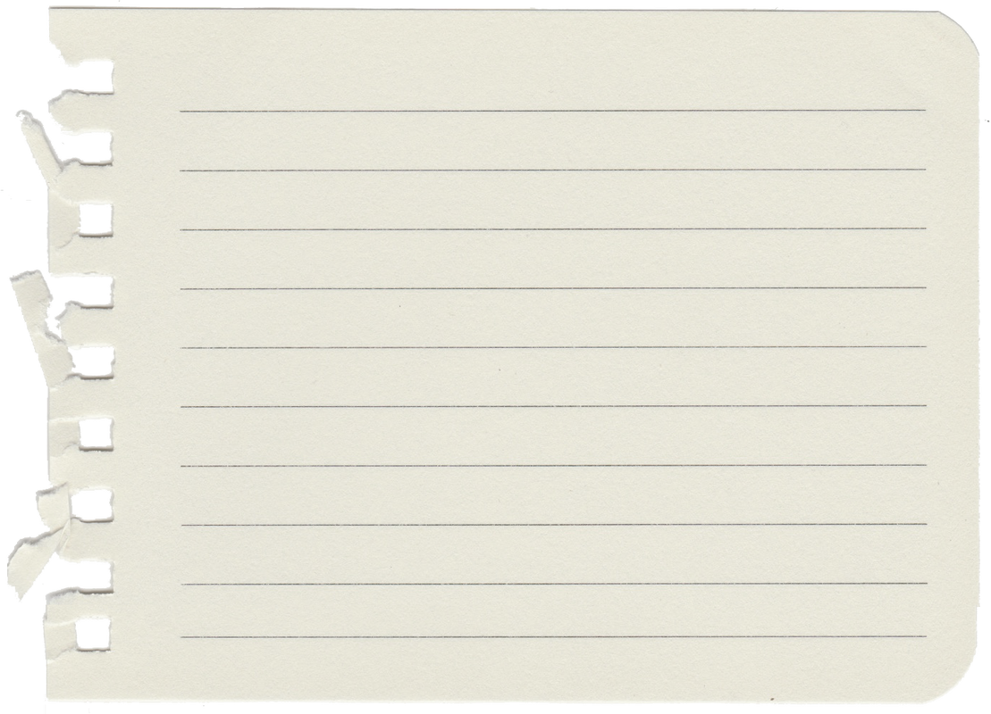
Thank You

